Slide 1
Chapter 6
Computer Arithmetic

Slide 2
Contents
Introduction
Binary, Octal, Decimal, Hexadecimal representation
Integer Numbers: Sign-Magnitude
1's complement
2's complement
Addition and Subtraction
Multiplication Algorithm

Slide 3
Data Types
Data Types:
  Binary information is stored in memory or processor registers
  Registers contain either data or control information
    Data are numbers and other binary-coded information
    Control information is a bit or a group of bits used to specify the sequence of command signals
  Data types found in the registers of digital computers
    Numbers used in arithmetic computations
    Letters of the alphabet used in data processing
    Other discrete symbols used for specific purpose
  The binary number system is the most natural system to use in a digital computer
  Number Systems
    Base or Radix r system : uses distinct symbols for r digits
    Most common number system :Decimal, Binary, Octal, Hexadecimal
    Positional-value(weight) System : r² r ¹r⁰.r⁻¹ r⁻² r⁻³
      Multiply each digit by an integer power of r and then form the sum of all weighted digits

Slide 4
Data Types
  Decimal System/Base-10 System
    Composed of 10 symbols or numerals(0, 1, 2, 3, 4, 5, 6, 7, 8, 9)
  Binary System/Base-2 System
    Composed of 2 symbols or numerals(0, 1)
    Bit = Binary digit
  Octal System/Base-8 System
    Composed of 8 symbols or numerals(0, 1, 2, 3, 4, 5, 6, 7)
    Bit = Binary digit
  Hexadecimal System/Base-16 System :
    Composed of 16 symbols or numerals(0, 1, 2, 3, 4, 5, 6, 7, 8, 9, A, B, C, D, E, F)
  Binary-to-Decimal Conversions
1011.101₂ = (1 x 2³) + (0 x 2²)+ (1 x 2¹) + (1 x 2º) + (1 x 2⁻¹) + (0 x 2⁻²) + (1 x 2⁻³)
= 8₁₀+ 0 + 2₁₀ + 1₁₀ + 0.5₁₀ + 0 + 0.125₁₀
= 11.625₁₀
  Octal-to-Decimal Conversions
(736.4)₈ = 7 x 8² + 3 x 8¹ + 6 x 8⁰ + 4 x 8⁻¹
= 7 x 64 + 3 x 8 + 6 x 1 + 4/8 = (478.5)₁₀
  Hexadecimal-to-Decimal Conversions
(F3)₁₆ = F x 16 + 3 = 15 x 16 + 3 = (243)₁₀

Slide 5
Data Types
  Conversion of decimal 41.6875 into binary
    Repeated division
    Integer = 41
    41 / 2 = 20 remainder 1
20 / 2 = 10 remainder 0
10 / 2 = 5 remainder 0
5 / 2 = 2 remainder 1
2 / 2 = 1 remainder 0
1 / 2 = 0 remainder 1
  Read the result upward to give an answer of (41)₁₀ = (101001)₂
  Fraction = 0.6875
  0.6875 x 2 = 1.3750 integer 1
  1.3750 x 2 = 0.7500 integer 0
    0.7500 x 2 = 1.5000 integer 1
    1.5000 x 2 = 1.0000 integer 1
  Read the result downward (0.6875)₁₀ = (0.1011)₂
  (41.6875)₁₀ = (101001.1011)₂
(binary number will end with 1) : LSB
(binary number will start with 1) : MSB
  (ignore the integral part and multiply only the fractional part until you get 0’s in fractional part )
MSB
LSB

Slide 6
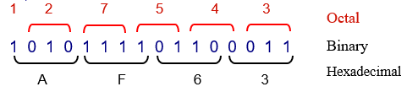
Data Types
Hex-to-Decimal Conversion
2AF₁₆ = (2 x 16²) + (10 x 16¹) + (15 x 16º)
= 512₁₀ + 160₁₀ + 15₁₀
= 687₁₀
Decimal-to-Hex Conversion
423₁₀ / 16 = 26 remainder 7 (Hex number will end with 7) : LSB
26₁₀ / 16 = 1 remainder 10
1₁₀ / 16 = 0 remainder 1 (Hex number will start with 1) : MSB
  Read the result upward to give an answer of 423₁₀ = 1A7₁₆
Hex-to-Binary Conversion
9F2₁₆ = 9 F 2
= 1001 1111 0010
= 100111110010₂
Binary, octal, and hexadecimal Conversion
Hex Binary Decimal
0 0000 0
1 0001 1
2 0010 2
3 0011 3
4 0100 4
5 0101 5
6 0110 6
7 0111 7
8 1000 8
9 1001 9
A 1010 10
B 1011 11
C 1100 12
D 1101 13
E 1110 14
F 1111 15
14 0001 0100 20
F8 1111 1000 248
  Binary-to-Hex Conversion
1 1 1 0 1 0 0 1 1 0₂ = 0 0 1 1 1 0 1 0 0 1 1 0
3 A 6
= 3A6₁₆

Slide 7
Data Types
  Binary-Coded-Decimal Code
    Each digit of a decimal number is represented by its binary equivalent
8 7 4 (Decimal)
1000 0111 0100 (BCD)
    Only the four bit binary numbers from 0000 through 1001 are used
    Comparison of BCD and Binary
137₁₀ = 10001001₂ (Binary) - require 8 bits
137₁₀ = 0001 0011 0111_{BCD} (BCD) - require 12 bits
  Alphanumeric Representation
    Alphanumeric character set
      10 decimal digits, 26 letters, special character($, +, =,….)
      ASCII(American Standard Code for Information Interchange)
      Standard alphanumeric binary code uses seven bits to code 128 characters

Slide 8
ASCII Table
Character Binary code Character Binary code Character Binary code Character Binary code
A 100 0001 U 101 0101 0 011 0000 / 010 1111
B 100 0010 V 101 0110 1 011 0001 , 010 1100
C 100 0011 W 101 0111 2 011 0010 = 011 1101
D 100 0100 X 101 1000 3 011 0011
E 100 0101 Z 101 1010 4 011 0100
F 100 0110 5 011 0101
G 100 0111 6 011 0110
H 100 1000 7 011 0111
I 100 1001 8 011 1000
J 100 1010 9 011 1001
K 100 1011
L 100 1100
M 100 1101 space 010 0000
N 100 1110 . 010 1110
O 100 1111 ( 010 1000
P 101 0000 + 010 1011
Q 101 0001 $ 010 0100
R 101 0010 * 010 1010
S 101 0011 ) 010 1001
T 101 0100 - 010 1101

Slide 9
Complements
Complements are used in digital computers for simplifying the subtraction operation and for logical manipulation
There are two types of complements for base r system
    1) r’s complement 2) (r-1)’s complement
      Binary number : 2’s or 1’s complement
      Decimal number : 10’s or 9’s complement
  (r-1)’s Complement
    (r-1)’s Complement of N = (r^{n}-1)-N
      9’s complement of N=546700
      (10⁶-1)-546700= (1000000-1)-546700= 999999-546700
      = 453299
      1’s complement of N=101101
      (2⁶-1)-101101= (1000000-1)-101101= 111111-101101
      = 010010
  r’s Complement
    r’s Complement of N = r^{n}-N for N != 0 and 0 for N=0
      10’s complement of 2389= (10⁴ -2389)= (10000-2389) =7611
      2’s complement of 1101100= 0010011+1= 0010100
N : given number
r : base
n : no of digits in the given number
546700(N) + 453299(9’s com)
=999999
101101(N) + 010010(1’s com)
=111111
* r’s Complement
(r-1)’s Complement +1 =(r^{n}-1)-N+1= r^{n}-N

Slide 10
Subtraction of Unsigned Numbers
  Subtraction of Unsigned Numbers
    1) M + (r^{n}-N)
    2) M ≥ N : Discard end carry, Result = M-N
    3) M < N : No end carry, Result = - r’s complement of (N-M)
      Decimal Example
      72532(M) - 13250(N) = 59282
      72532
      + 86750 (10’s complement of 13250)
      1 59282
      Result = 59282
      Binary Example
      1010100(X) - 1000011(Y) = 0010001
      1010100
      + 0111101 (2’s complement of 1000011)
      1 0010001
      Result = 0010001
      13250(M) - 72532(N) = -59282
      13250
      + 27468 (10’s complement of 72532)
      0 40718
      Result = -(10’s complement of 40718)
      = -(59281+1) = -59282
M < N
M ≥ N
Discard End Carry
No End Carry
      1000011(X) - 1010100(Y) = -0010001
      1000011
      + 0101100 (2’s complement of 1010100)
      0 1101111
      Result = -(2’s complement of 1101111)
      = -(0010000+1) = -0010001
X < Y
X ≥ Y
No End Carry
Discard End Carry

Slide 11
Practice Examples
1. Convert the following binary numbers to decimal :
  101110 b. 1110101 c. 110110100
2. Convert the following numbers with the indicated bases to decimal :
  (12121)₃ b. (4310)₅ c. (50)₇
3. Obtain 9’s & 10’s complement of the following eight-digit decimal numbers:
  12349876 b. 00980100 c. 90009951
4. Perform the subtraction with the following unsigned decimal numbers by taking the 10’s complement of the subtrahend
  5250-1321
  1753-8640
  20-100
  1200-250
5. Perform the subtraction with the following unsigned binary numbers by taking the 2’s complement of the subtrahend
  11010-10000
  11010-1101
  100-110000
  1010100-1010100

Slide 12
Thank You.

Slide 13
Addition ad Subtraction
All the arithmetic operations can be performed by addition,subtraction,multiplication and division
Addition and Subtraction operations are performed on
  Signed magnitude data: 1 bit is used to represent the sign and other bits represent the magnitude.
  2’complement data

Slide 14
Addition and Subtraction with Signed-Magnitude Data
Addition Algorithm:
  When the signs of A and B are identical ,add the 2 magnitudes and attach the sign of A to the result
  When the signs of A and B are different, compare the magnitudes and subtract the smaller number from larger.
Subtraction Algorithm:
  When the signs of A and B are different ,add the 2 magnitudes and attach the sign of A to the result
  When the signs of A and B are identical, compare the magnitudes and subtract the smaller number from larger.
Choose the sign of the result to be same as A if A>B or complement of A if A<B
Operation | Add Magnitudes | Subtract Magnitudes
 |  | When A>B | When A<B | When A=B
(+A) + (+B) | +(A+B)
(+A) + (-B) |  | +(A-B) | -(B-A) | +(A-B)
(-A) + (+B) |  | -(A-B) | +(B-A) | +(A-B)
(-A) + (-B) | -(A+B)
(+A) - (+B) |  | +(A-B) | -(B-A) | +(A-B)
(+A) - (-B) | +(A+B)
(-A) - (+B) | -(A+B)
(-A) - (-B) |  | -(A-B) | +(B-A) | +(A-B)

Slide 15
Hardware implementation
A and B be two registers that hold the magnitudes of No
As and Bs be two flip-flops that hold the corresponding signs
The Result is transferred into A and As.
Parallel adder is needed to perform the micro operation A + B.
Output carry are transferred to E flip-flop
  Where it can be checked to determine the relative magnitude of the Nos.
Add overflow flip-flop (AVF) holds the overflow bit when A and B are added.
Bs
B register
M
(mode control)
AVF
Complementer
Output carry
E
Parallel Adder
Input carry
S
A register
Load Sum
As
M=0,Input Carry=0 → A+B
M=1,Input Carry=1 → A+B’+1

Slide 16
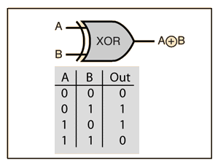
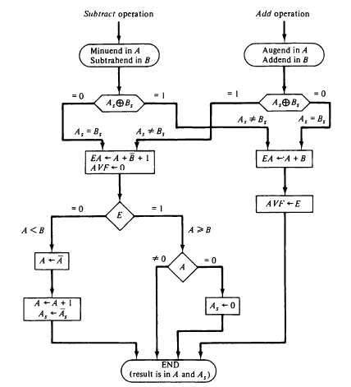
Hardware Algorithm
Addition:
Signs are same ->add
Signs are different->subtract
Subtraction:
Signs are same ->subtract
Signs are different->add

Slide 17
Addition and Subtraction
2’s Complement data
Left most bit of a binary number represents sign-bit. (0 for =ve and 1 for –ve)
If sign bit=1, then the entire number is represented in 2’complement form.
Example +33 00100001
-33 11011111
Addition:
  Add the numbers and treat the sign bits same as other bits
  Carry out of the sign bit position is discarded
Subtraction:
  Take the 2’complement of the subtrahend and add it to minuend

Slide 18
Addition and Subtraction
Overflow: When two n-bit numbers are added and the sum occupies n+1 bits
The overflow can be detected by applying the last two carries out of the addition to an XOR gate. A ‘1’ at the output indicates an overflow.

Slide 19
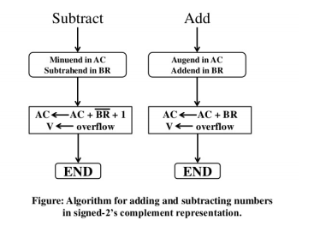
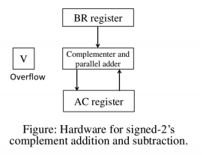
Hardware and Algorithm for Signed 2’s complement Data

Slide 21
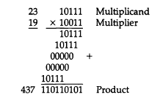
Multiplication Algorithm

Slide 22
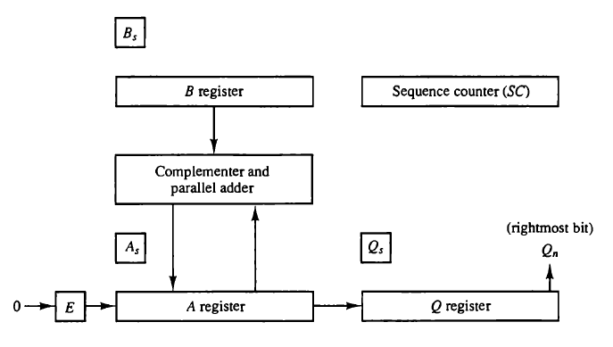
Hardware for Multiply operation

Slide 23
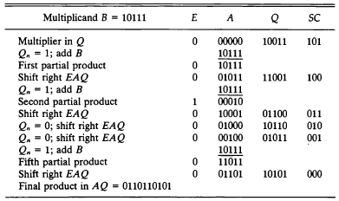
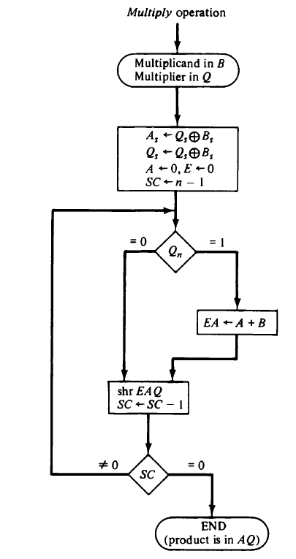
Flow Chart for Multiply operation

Slide 24
Booth Multiplication Algorithm
Booth algorithm gives a procedure for multiplying binary integers in signed 2’s complement representation in efficient way, i.e., less number of additions/subtractions required.
It operates on the fact that strings of 0’s in the multiplier require no addition but just shifting and a string of 1’s in the multiplier from bit weight 2^k to weight 2^m can be treated as 2^(k+1 ) to 2^m.
Example: (+14) is represented as 001110 has string of 1’s from 2³ to 2¹.
Here K=3,m=1
(+14) can be represented as 2^{k+1}-2^{m=}2⁴-2¹=16-2=14.
MX14 = MX2⁴-MX2¹

Slide 25
Booth Multiplication Algorithm
As in all multiplication schemes, booth algorithm requires examination of the multiplier bits and shifting of the partial product.
Prior to the shifting, the multiplicand may be added to the partial product, subtracted from the partial product, or left unchanged according to following rules:
  The multiplicand is subtracted from the partial product upon encountering the first least significant 1 in a string of 1’s in the multiplier
  The multiplicand is added to the partial product upon encountering the first 0 (provided that there was a previous ‘1’) in a string of 0’s in the multiplier.
  The partial product does not change when the multiplier bit is identical to the previous multiplier bit.

Slide 26
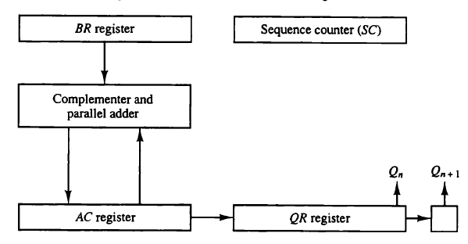
Hardware Implementation of Booths Algorithm
We name the register as A, B and Q, AC, BR and QR respectively.
Qn designates the least significant bit of multiplier in the register QR.
An extra flip-flop Qn+1is appended to QR to facilitate a double inspection of the multiplier.

Slide 27
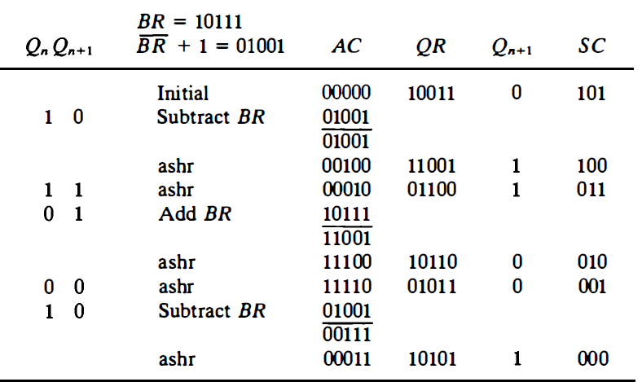
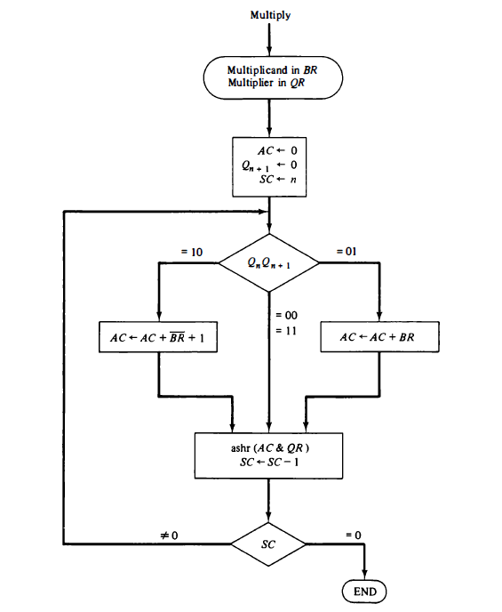
Flowchart

Slide 28
Practice Examples
Show the contents of E,A,Q and SC during the process of multiplication of two binary numbers, 11111 (multiplicand) and 10101(multiplier). The signs are not included.
Show the step-by-step multiplication process using Booth algorithm when the following binary numbers are multiplied. Assume 5-bit registers that hold signed numbers.
  (+15) X (+13)
  (+15) X (-13)

